Slide 1
Need of programming Languages
Computers can execute tasks very rapidly and assist humans
Programming languages – Helps for communication between human and machines.
They can handle a greater amount of input data.
But they cannot design a strategy to solve problems for you

Slide 2
Python – Why?
Simple syntax
Programs are clear and easy to read
Has powerful programming features
Companies and organizations that use Python include YouTube, Google, Yahoo, and NASA.
Python is well supported and freely available at www.python.org.

Slide 3

Python – Why?
Guido van Rossum – Creator
Released in the early 1990s.
Its name comes from a 1970s British comedy sketch television show called Monty Python’s Flying Circus.

Slide 4
Python….
High-level language; other high-level languages you might have heard of are C, C++, Perl, and Java.
There are also low-level languages, sometimes referred to as “machine languages” or “assembly languages.”
Computers can only run programs written in low-level languages.
So programs written in a high-level language have to be processed before they can run.

Slide 5
Python….
Python is considered an interpreted language because Python programs are executed by an interpreter.
There are two ways to use the interpreter:
interactive mode and script mode.

Slide 6
Python….Interactive mode
In interactive mode, you type Python programs and the interpreter displays the result:
>>> 1 + 1 2
The shell prompt, >>>, is the prompt the interpreter uses to indicate that it is ready. If you type 1 + 1, the interpreter replies 2.

Slide 7
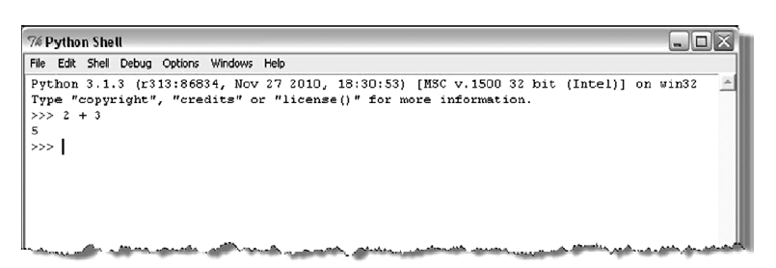
Python …. Shell

Slide 8
Python…. Script Mode
Can also store code in a file and use the interpreter to execute the contents of the file, which is called a script.
Python scripts have names that end with .py.
Interactive mode is convenient for testing small pieces of code because you can type and execute them immediately.
But for anything more than a few lines, should save your code as a script so you can modify and execute it in future.

Slide 9
Python….Script Mode …
File name : first.py
print(4+3) print(4-3) print(4>3) print("hello World")

Slide 10
Problem
Little Bob loves chocolate, and he goes to a store with Rs. N in his pocket. The price of each chocolate is Rs. C. The store offers a discount: for every M wrappers he gives to the store, he gets one chocolate for free. This offer is available only once. How many chocolates does Bob get to eat?

Slide 11
PAC For Chocolate Problem
Input | Processing | Output
Amount in hand, N Price of one chocolate, C Number of wrappers for a free chocolate, M | Number of Chocolates P = Quotient of N / C Free chocolate F = Quotient of P/M | Total number of chocolates got by Bob

Slide 12
Pseudocode
READ N and C
COMPUTE num_of_chocolates as N/C
CALCULATE returning_wrapper as number of chocolates/m
TRUNCATE decimal part of returning_wrapper
COMPUTE Chocolates_recieved as num_of_chocolates + returning_wrapper
PRINT Chocolates_recieved

Slide 13
Knowledge Required
Following knowledge is required in Python to write a code to solve the above problem
Read input from user
Data types in Python
Perform arithmetic calculations
Write output

Slide 14
What is an Identifier?
An identifier is a sequence of one or more characters used to name a given program element.
In Python, an identifier may contain letters and digits, but cannot begin with a digit.
Special underscore character can also be used
Example : line, salary, emp1, emp_salary

Slide 15
Rules for Identifier
Python is case sensitive, thus, Line is different from line.
Identifiers may contain letters and digits, but cannot begin with a digit.
The underscore character, _, is also allowed to aid in the readability of long identifier names. Should not be the first character.
Spaces are not allowed as part of an identifier.

Slide 16
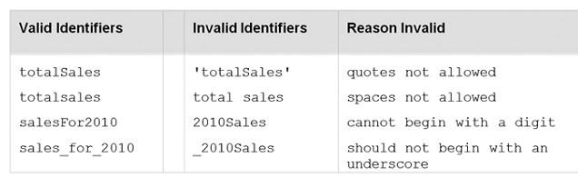
Identifier Naming

Slide 17

Keywords
A keyword is an identifier that has pre-defined meaning in a programming language.
Therefore, keywords cannot be used as “regular” identifiers. Doing so will result in a syntax error, as demonstrated in the attempted assignment to keyword and below,

Slide 18
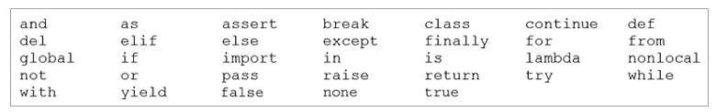
Keywords in Python

Slide 19

Variables and Identifiers
A variable is a name (identifier) that is associated with a value.
A simple description of a variable is “a name that is assigned to a value,”
Variables are assigned values by use of the assignment operator, num = 10
num = num + 1

Slide 20


Wherever a variable appears in a program (except on the left-hand side of an assignment statement), it is the value associated with the variable that is used, and not the variable’s name,
Variables are assigned values by use of the assignment operator , = ,

Slide 21
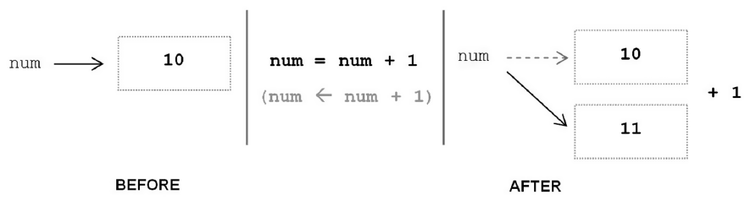
Assignment statements often look wrong to novice programmers. Mathematically, num = num + 1 does not make sense. In computing, however, it is used to increment the value of a given variable by one. It is more appropriate, therefore, to think of the = symbol as an arrow symbol
When thought of this way, it makes clear that the right side of an assignment is evaluated first, then the result is assigned to the variable on the left. An arrow symbol is not used simply because there is no such character on a standard computer keyboard.

Slide 22
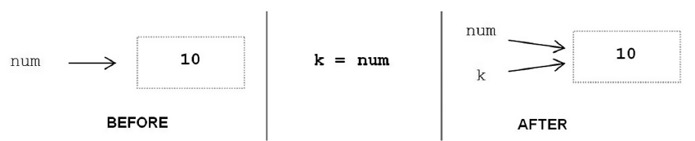

Variables may also be assigned to the value of another variable,
Variables num and k are both associated with the same literal value 10 in memory. One way to see this is by use of built-in function id,
The id function produces a unique number identifying a specific value (object) in memory. Since variables are meant to be distinct, it would appear that this sharing of values would cause problems.

Slide 23
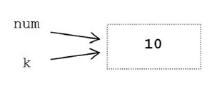
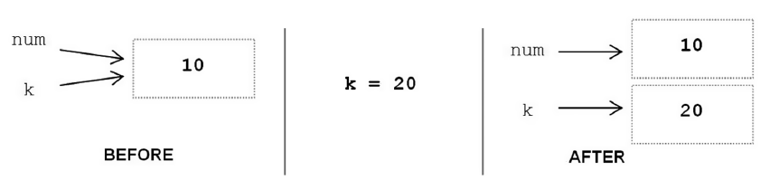
If the value of num changed, would variable k change along with it?
This cannot happen in this case because the variables refer to integer values, and integer values are immutable. An immutable value is a value that cannot be changed. Thus, both will continue to refer to the same value until one (or both) of them is reassigned,
If no other variable references the memory location of the original value, the memory location is deallocated (that is, it is made available for reuse).

Slide 24
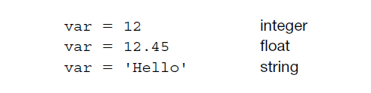
Finally, in Python the same variable can be associated with values of different type during program execution,
(The ability of a variable to be assigned values of different type is referred to as dynamic typing, introduced later in the discussions of data types.)

Slide 25
Comments
Meant as documentation for anyone reading the code
Single-line comments begin with the hash character ("#") and are terminated by the end of line.
Python ignores all text that comes after # to end of line
Comments spanning more than one line are achieved by inserting a multi-line string (with """ as the delimiter one each end) that is not used in assignment or otherwise evaluated, but sits in between other statements.
#This is also a comment in Python
""" This is an example of a multiline comment that spans multiple lines ... "“”

Slide 26
Literals
A literal is a sequence of one or more characters that stands for itself.

Slide 27
Numeric literal
A numeric literal is a literal containing only the digits 0–9, an optional sign character (1 or 2), and a possible decimal point. (The letter e is also used in exponential notation).
If a numeric literal contains a decimal point, then it denotes a floating-point value, or “float” (e.g., 10.24); otherwise, it denotes an integer value (e.g., 10).
Commas are never used in numeric literals

Slide 28
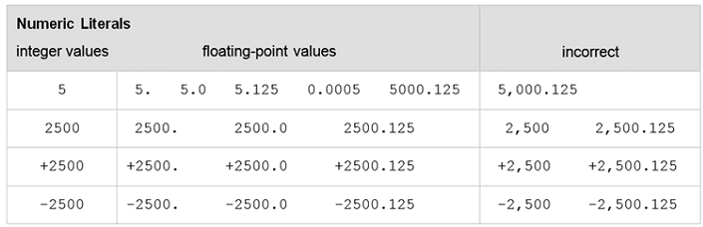
Numeric Literals in Python
Since numeric literals without a provided sign character denote positive values,
an explicit positive sign character is rarely used.

Slide 29
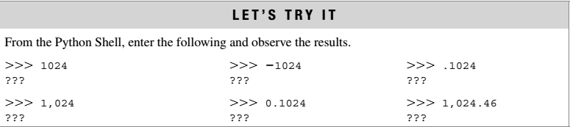

Slide 30
String Literals
String literals, or “strings,” represent a sequence of characters, 'Hello' 'Smith, John' "Baltimore, Maryland 21210“
In Python, string literals may be surrounded by a matching pair of either single (') or double (") quotes.
>>> print('Welcome to Python!') >>>Welcome to Python!

Slide 31
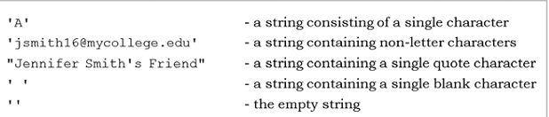
String Literal Values

Slide 32
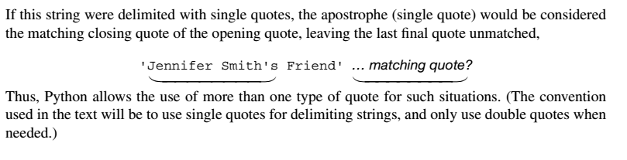
Note

Slide 33
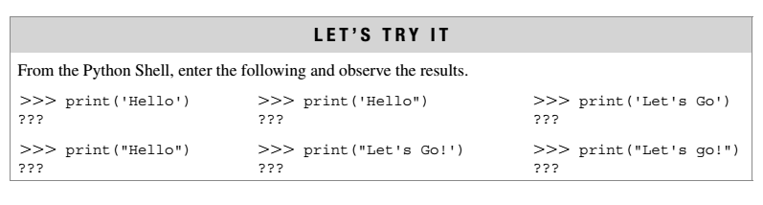

Slide 34
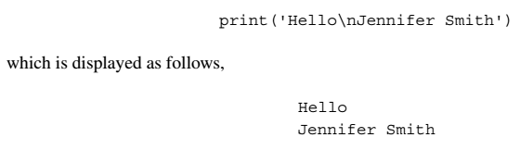
Control Characters
Special characters that are not displayed on the screen. Rather, they control the display of output
Do not have a corresponding keyboard character
Therefore, they are represented by a combination of characters called an escape sequence.
The backslash (\) serves as the escape character in Python.
For example, the escape sequence '\n', represents the newline control character, used to begin a new screen line

Slide 35
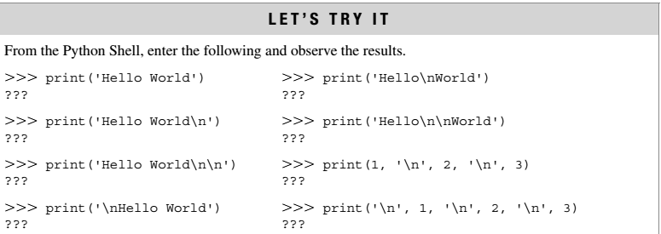

Slide 36
Data Types
Python's data types are built in the core of the language
They are easy to use and straightforward.
Data types supported by Python
Boolean values
None
Numbers
Strings
Tuples
Lists
Sets
Dictionaries

Slide 37
Boolean values
Primitive datatype having one of two values: True or False
some common values that are considered to be True or False

Slide 38
Boolean values
print bool(True) | True
print bool(False) | False
print bool("text") | True
print bool("") | False
print bool(' ') | True
print bool(0) | False
print bool() | False
print bool(3) | True
print bool(None) | False

Slide 39
None
Special data type - None
Basically, the data type means non existent, not known or empty
Can be used to check for emptiness

Slide 40
Numbers
Types of numbers supported by Python:
Integers
floating point numbers
complex numbers
Fractional numbers

Slide 41
Integers
Integers have no fractional part in the number
Integer type automatically provides extra precision for large numbers like this when needed
>>> a = 10
>>> b = a

Slide 42
Binary, Octal and Hex Literals
0b1, 0b10000, 0b11111111 # Binary literals: base 2, digits 0-1
0o1, 0o20, 0o377
# Octal literals: base 8, digits 0-7
0x01, 0x10, 0xFF # Hex literals: base 16, digits 0-9/A-F
(1, 16, 255)

Slide 43
Conversion between different bases
Provides built-in functions that allow you to convert integers to other bases’ digit strings
oct(64), hex(64), bin(64)
# Numbers=>digit strings ('0o100', '0x40', '0b1000000')
These literals can produce arbitrarily long integers

Slide 44
Numbers can be very long
>>> X = 0xFFFFFFFFFFFFFFFFFFFFFFFFFFFF
>>> X 5192296858534827628530496329220095
>>> oct(X) '0o17777777777777777777777777777777777777‘
>>> bin(X) '0b111111111111111111111111111111111111111111111111111111111
...and so on... 11111‘

Slide 45
Floating Point Numbers
Number with fractional part
>>> 3.1415 * 2
>>>6.283

Slide 46
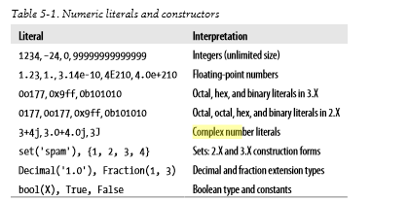
Floating Point Numbers

Slide 47
Arithmetic overflow
a condition that occurs when a calculated result is too large in magnitude (size) to be represented, >>>1.5e200 * 2.0e210 >>> inf This results in the special value inf (“infi nity”) rather than the arithmetically correct result 3.0e410, indicating that arithmetic overflow has occurred.

Slide 48
Arithmetic underflow
a condition that occurs when a calculated result is too small in magnitude to be represented, >>>1.0e-300 / 1.0e100 >>>0.0
This results in 0.0 rather than the arithmetically correct result 1.0e-400, indicating that arithmetic underflow has occurred.

Slide 49
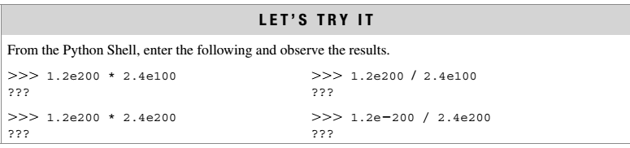
Arithmetic overflow occurs when a calculated result is too large in magnitude to be represented. Arithmetic underflow occurs when a calculated result is too small in magnitude to be represented

Slide 50
Repeated Print
>>>print(‘a’*15)
# prints ‘a’ fifteen times
>>>print(‘\n’*15)
# prints new line character fifteen times

Slide 51
Complex Numbers
A complex number consists of an ordered pair of real floating point numbers denoted by a + bj, where a is the real part and b is the imaginary part of the complex number.
complex(x) to convert x to a complex number with real part x and imaginary part zero
complex(x, y) to convert x and y to a complex number with real part x and imaginary part y.
x and y are numeric expressions

Slide 52
Complex Numbers
>>> 1j * 1J
(-1+0j)
>>> 2 + 1j * 3
(2+3j)
>>> (2 + 1j) * 3
(6+3j)
A = 1+2j; B=3+2j
# Mutiple statements can be given in same line using semicolon
C = A+B; print(C)

Slide 53
Complex Numbers
# prints real part of the number
print(A.real)
# prints imaginary part of the number
print(A.imag)
# Can do operations with part of complex number
print(A.imag+3)

Slide 54
Input and output function
Input function : input
Basic_pay = input('Enter the Basic Pay: ')
Output function : print
print('Hello world!')
print(‘Net Salary', salary)

Slide 55
By Default…
Input function reads all values as strings, to convert then to integers and float, use the function int() and float()

Slide 56
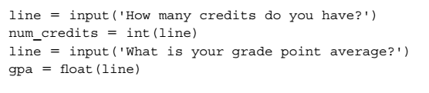
Type conversion…
Here, the entered number of credits, say '24', is converted to the equivalent integer value, 24, before being assigned to variable num_credits. For input of the gpa, the entered value, say '3.2', is converted to the equivalent floating-point value, 3.2. Note that the program lines above could be combined as follows,

